Slide 1
Responding to Text & Informative Writing
Inman Middle School
6th Grade ELA

Slide 3
How do I respond to text?
R.A.C.E.
RACE, an acronym, is a simple writing strategy that can help you develop more thoughtful and thorough responses to writing prompts.

Slide 4
R.A.C.E.
RESTATE –restate the question in the form of a topic sentence using key words.
The purpose of the topic sentence is to make it clear to your reader what you are talking about.
- Add interesting details about the topic to
grab the reader’s attention.

Slide 5
R.A.C.E.
ANSWER –answer ALL parts of the question. Your answer becomes your thesis statement.
The purpose of the thesis statement and topic sentence is to make it clear to your reader what you are talking about.
- A thesis statement is the main idea of the overall
writing piece.
- The thesis should be stated in the introduction
and restated in the conclusion.

Slide 6
R.A.C.E.
CITE –cite examples from the text that support your answer. Also, clarify your examples.
Use examples from text, graphs, data, or pictures.

Slide 7
R.A.C.E.
EXPLAIN – explain how the evidence supports the answer or connects to another text.
Extend your thinking. Make a connection to yourself, another text or the world.

Slide 8
Informational Texts
This text structure shows comparisons between similarities of information or a contrast between differences.
This text structure provides detailed description of an event or situation.
It shows causes for events and then the effects that occur.
This text structure sets up a problem and its solution.
This text structure places things in a sequence or in time order.
Compare/Contrast
Descriptive
Cause/Effect
Problem/Solution
Chronological Order

Slide 9
Comparison/Contrast
Comparison/contrast points out similarities and differences in two topics.
Egypt’s burial practices
Burial practices of my religion

Slide 10
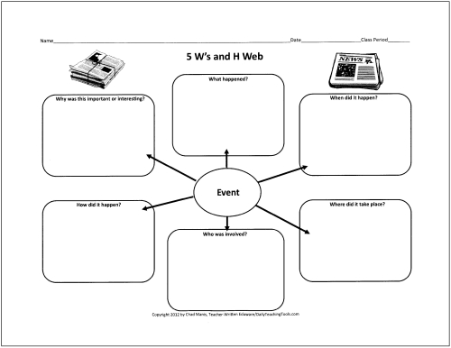
Descriptive
Descriptive writing paints a picture for the reader. It uses imagery that appeals to the five senses: taste, smell, touch, sound, and sight.

Slide 11
Cause/Effect
Cause/Effect writing shows relationship between events/ideas and their results or consequences.
Brakes don’t work
Bike doesn’t stop
Accident occurs

Slide 12
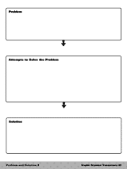
Problem/Solution
Problem/Solution writing discusses a problem, and then provides a plan
for its solution.

Slide 13
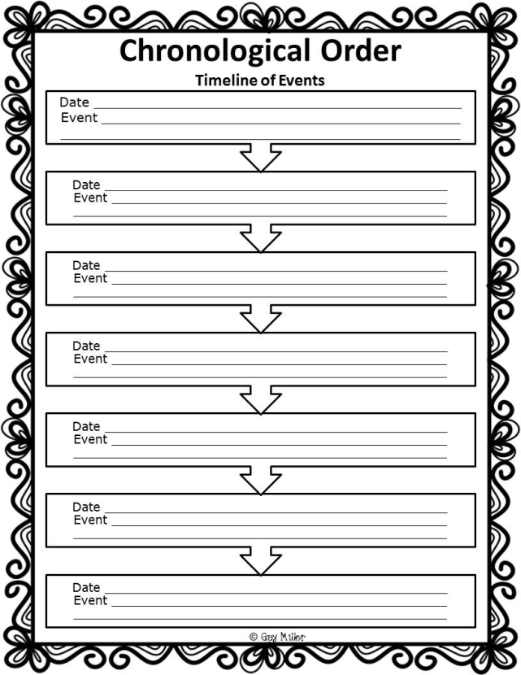
Chronological Order
Chronological Order is when information in a passage is organized by the time in which each event occurs.
Remember:
Chrono = Time
Logic = Order

Slide 14
Ways to Develop Your Writing
Use Transitions - words and phrases such as for example, mainly, and in addition that connect ideas in writing.
Purpose of transitions?
Transitions connect
ideas and make text
easier to understand.
Use Precise language: words that make a description as clear and sharp as possible.
Ex. “Wild behavior and
fiery temper” instead
of “bad attitude”
Ex. “Sling” instead of
“throw”

Slide 15
Transitional Words and Phrases
Compare/ Contrast | also, however, on the other hand, although, in the same way, similarly, another, like, too, but, likewise, unlike, moreover, yet
Cause/ Effect | as a result, consequently, so, because, since, therefore
Time | about, finally, often, after, first, second, soon, then, at last, immediately, thereafter, before, later, until, during, meanwhile, when, eventually, next, while
 | above, beneath, into, across, beside, near, among, between, next, around, by, over, before, down, behind, under, below
 | for example, for instance, in fact

Slide 16
F.E.A.R.S. and C.U.P.S.
F – Facts from the text
E – Examples to support the text
A - Anecdotes or personal stories
R – Rhetorical questions to promote thought
S – Statistics
C – Capitalization
U – Usage and Grammar
P – Punctuation
S - Spelling

Slide 17
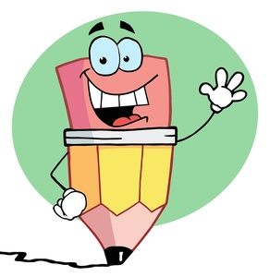
You are now ready to R.A.C.E. to the finish line of writing with the correct F.E.A.R.S. holding your victory C.U.P.S.!

